Slide 1
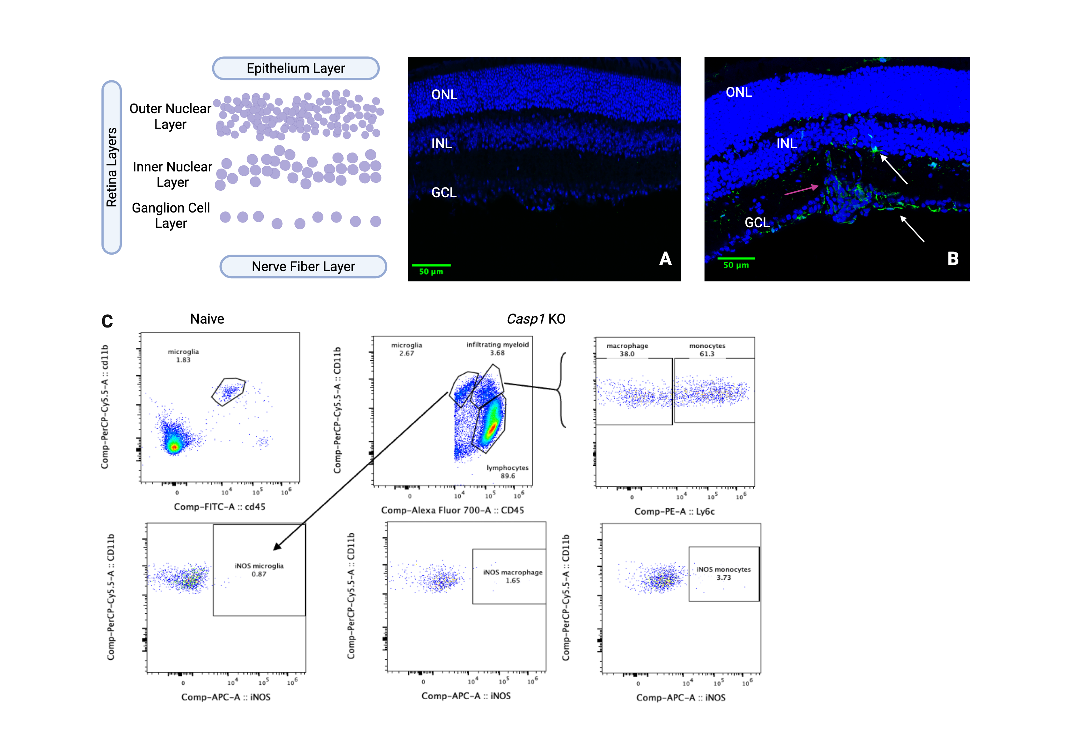
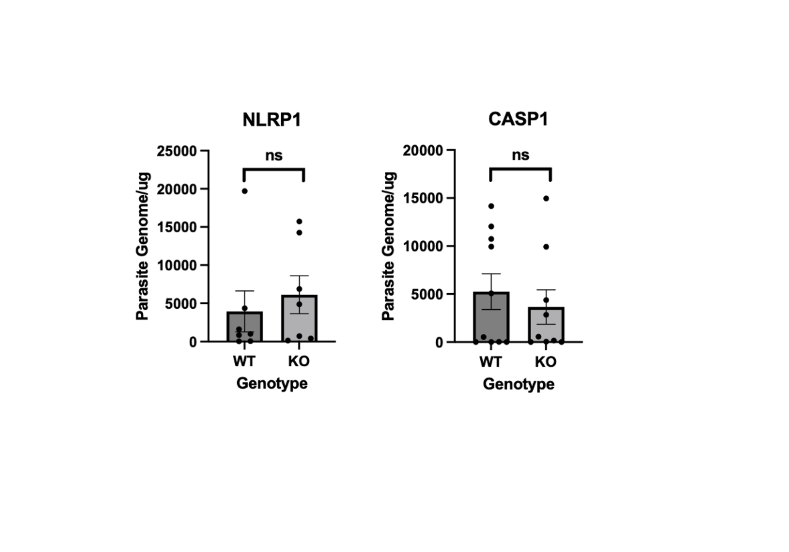

Role of NLRP1 inflammasome in ocular toxoplasmosis
Data Collection (or Methods)
Quantify degree of infection with qPCR
Measure populations of T cell and myeloid cells using flowcytometry
Visualize infection in the retina and quantify myeloid cell recruitment by staining for cell nuclei and IBA1+ cells.
[idk maybe a visual here you never know u know]
Incorporate one or more visuals helping you showcase materials, sources, images or data for your research here!
Seblework Alemu & Isaac Babcock
Contact: cnd3ru@virginia.edu
Summary
During chronic T.gondii infection, there is recruitment of lymphocytes and non-resident and resident myeloid cells in the eye
The myeloid cell response localizes in primarily retinal ganglion cells
While Casp1 plays a vital role in the myeloid response in the brain, it is not necessary the eye innate immune response to T.gondii
Background and Motivation
Uveitis describes an inflammatory response in the middle layer of the eye. It is one of the most common symptoms of infection from the parasite Toxoplasma gondii (T. gondii). During T. gondii infection, the protein NLRP1 is a recognizes signs of cellular disease and prompts the activation of caspase-1, which initates a pro-inflammatory signaling pathway. It remains unclear what is the molecular basis of eye inflammation.
This project asks: is NLRP1 and casp1 expression required to control the inflammatory response to T. gondii eye infection?
Conclusions & Next Steps
The following study sought to determine whether NLRP1 and casp1 expression is necessary for the eye’s inflammatory response to T. gondii. Intial experiments identified an infected myeloid response that consists of primarily infiltrating newly-populated myeloid cells. These cells appear to localize in the retinal ganglion cell bodies and inner nuclear layer of the retina.
Acknowledgements
Non-author collaborators, fiscal administrator(s), and funding sources can be named here.
Diagram of fig 1, and also maybe NLRP1 flow chart
Place department logo here

Slide 2
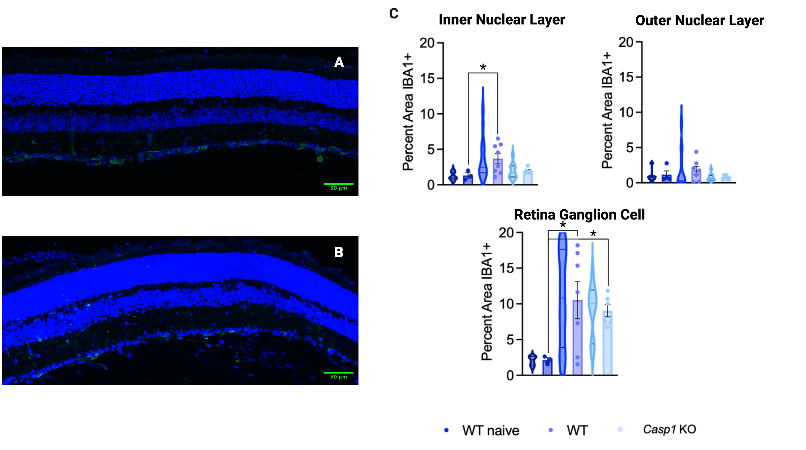
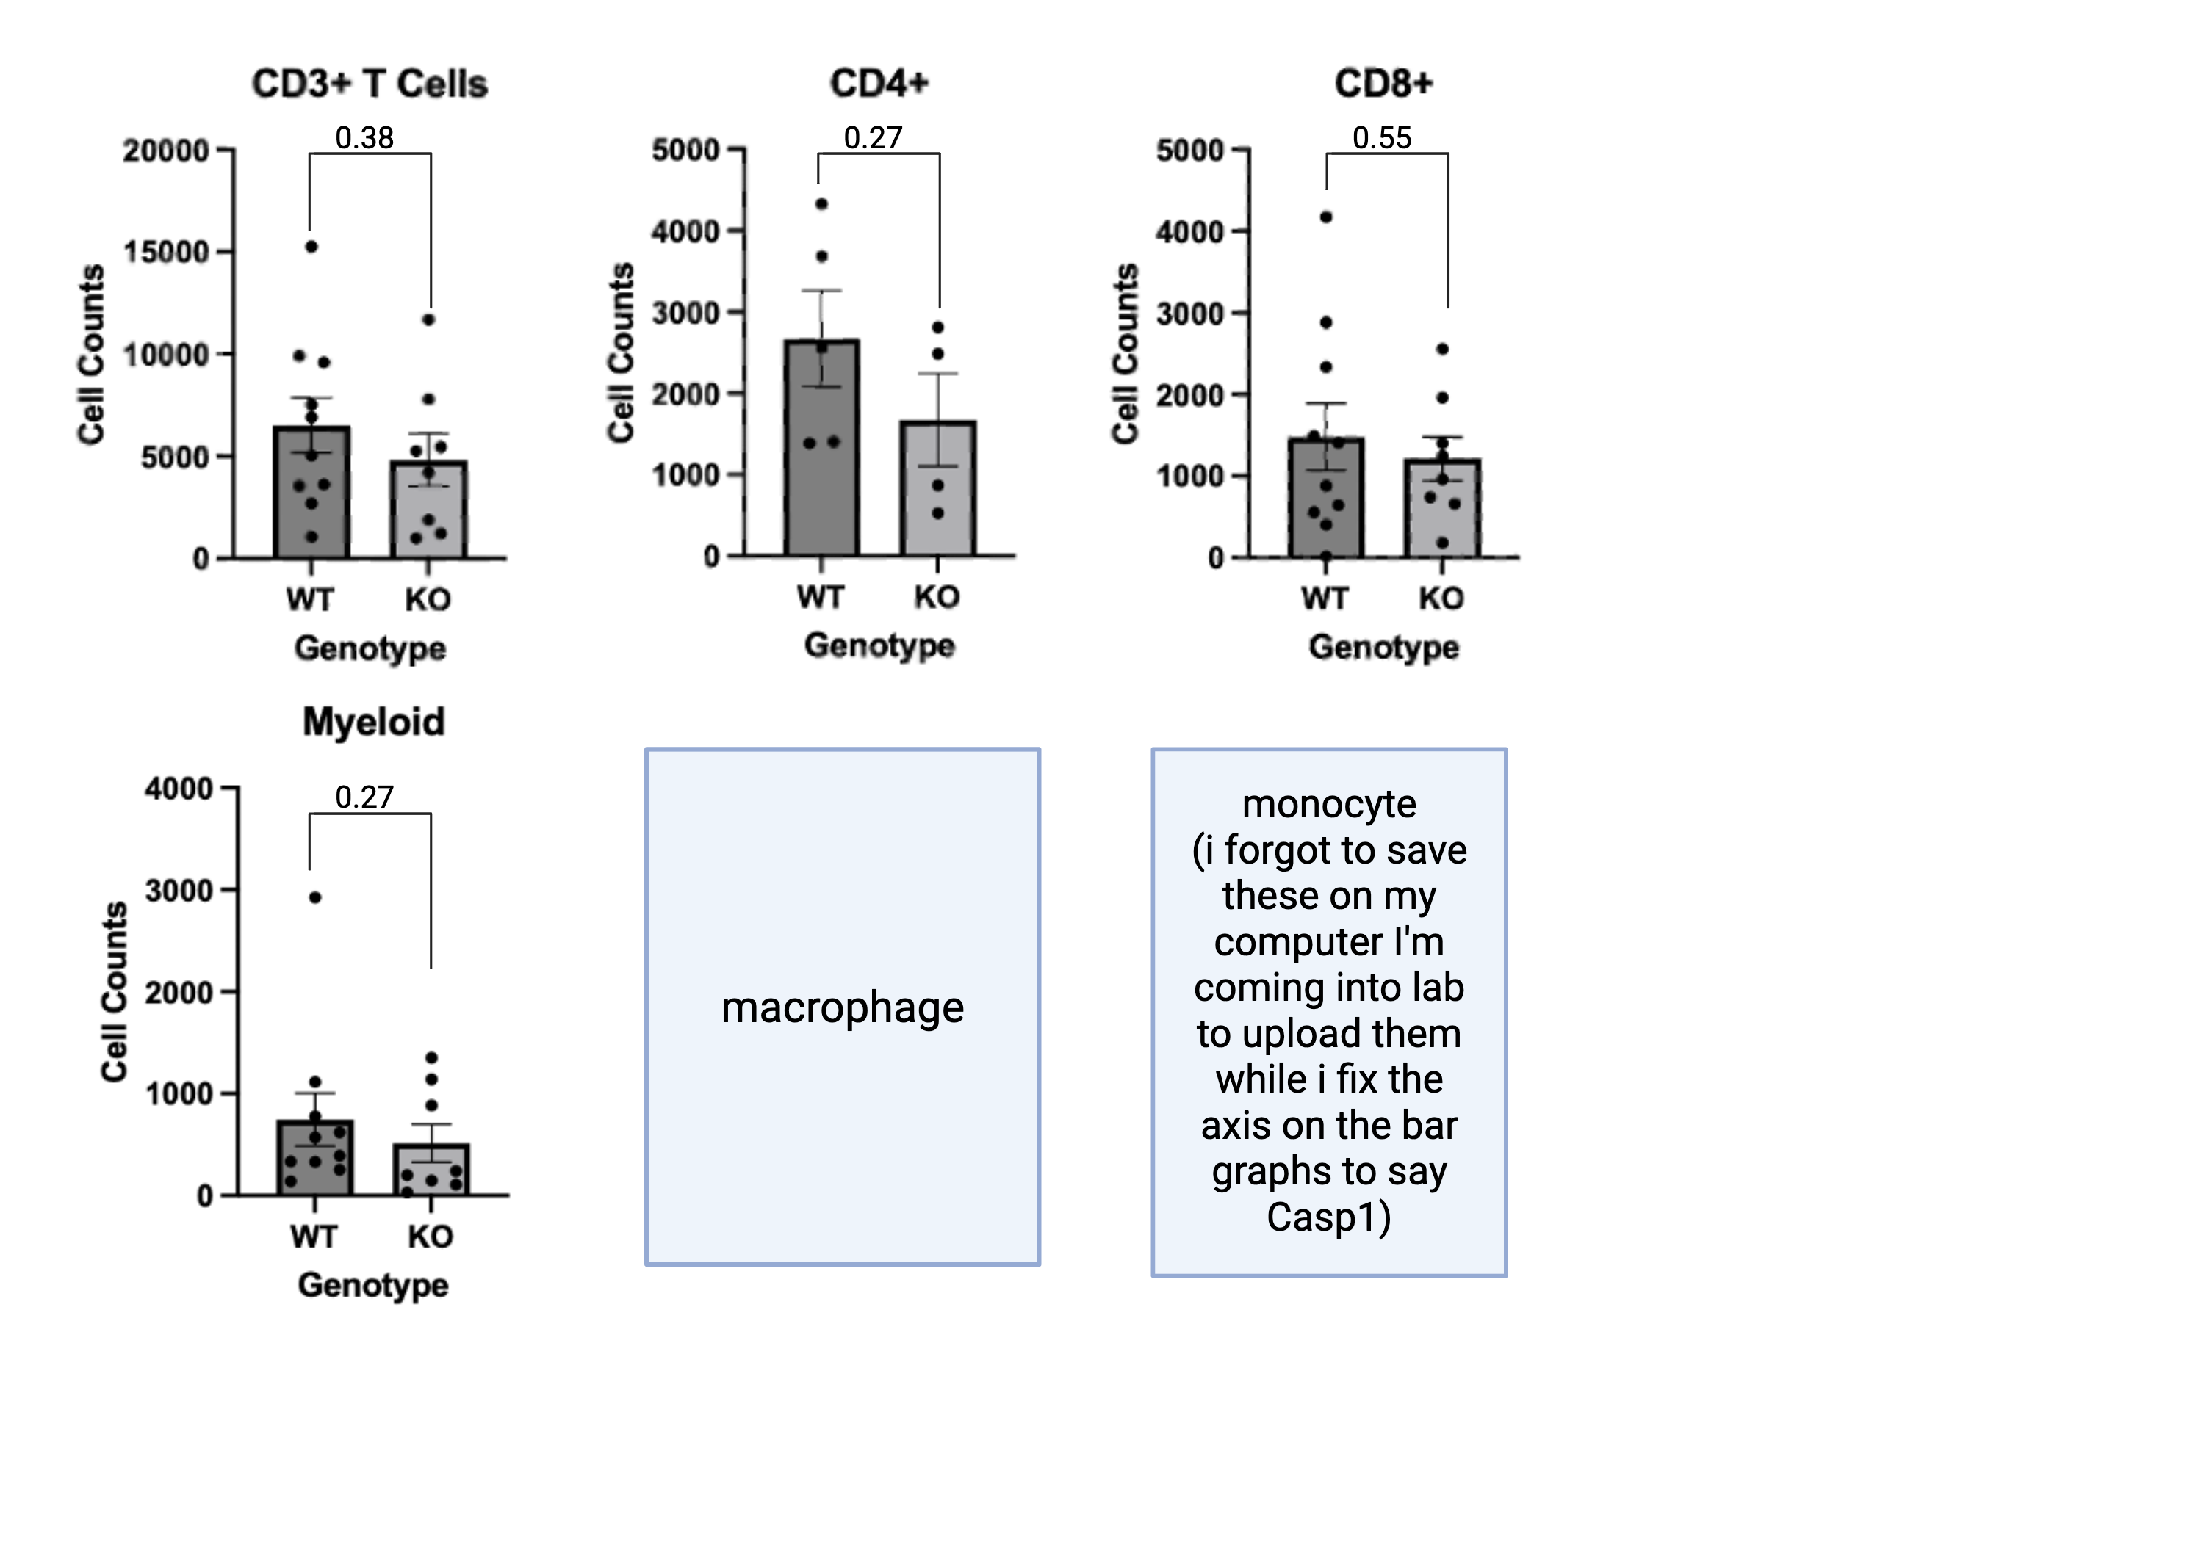
Role of NLRP1 inflammasome in ocular toxoplasmosis
Seblework Alemu, Isaac Babcock, Tajie Harris
Center for Brain Immunology and Glia, University of Virginia School of Arts and Sciences
Background & Motivation
Casp1 Role in Ocular Inflammation
& A
Casp1 is dispensable for ocular T. gondii control
& A
Uveitis describes an inflammatory response in the middle layer of the eye. It is one of the most common symptoms of infection from the parasite Toxoplasma gondii (T. gondii)¹. During T. gondii infection, the protein NLRP1 is a recognizes signs of cellular disease and prompts the activation of caspase-1, which initiates an inflammatory signaling pathway². This project examines whether NLRP1 and caspase-1 expression required to control the inflammatory response to T. gondii eye infection.
Figure 4. Loss of Caspase-1 or NLRP1 does not impact parasite burden in the eye. qPCR analysis of T. gondii parasite load 6 weeks post-infection in whole eye wildtype WT (n_{WT NLRP1}=7, n_{WT Casp1}=10) NLRP1 knockout (NLRP1 KO, n= 7), Casp1 knockout (Casp1 KO, n = 9).
Methods
Conclusions
Extract whole eyes from adult, sex matched NLRP1 -/- and casp1 -/- mice, 6W infection
Quantify degree of infection with qPCR
Measure T cell and myeloid cell populations using flowcytometry
Visualize and quantify myeloid cell recruitment by staining for cell nuclei and IBA1+ cells in the retina
During chronic T.gondii infection, there is recruitment of lymphocytes and significant increase in myeloid cell recruitment in the eye
The myeloid cell response in the retina localizes in primarily retinal ganglion cells and the inner nuclear layer
While Casp1 plays a vital role in the myeloid response in the brain³, it is not necessary for the pro-inflammatory eye response to T.gondii
Figure 2. Loss of Casp1 expression does not disturb IBA1+ cell recruitment response (A&B) Retina IHC staining in a wildtype and Casp1 KO, respectively (6WPI). IBA1+ cells green, DAPI cell nuclei blue. (C) LMER Analysis of percent area of IBA1+ cells in naïve(n=3), wildtype(n=11), and Casp1 KO mice(n=7) across the ganglion cell, inner nuclear, and outer nuclear layer of the retina.
Casp1 Role in Ocular Inflammation
& A
Inflammatory Response in Infected Eye
Acknowledgement
& A
I want to thank Dr. Tajie Harris and PhD candidate Isaac Babcock for their supervision and support as well as the entirety of the Harris lab. This work was supported by the Double Hoo award provided by UVA. Figures were made with BioRender.
Pre-gated on size,
singlet, live, CD45hi CD11b hi
References
& A
Figure 3. Caspase-1 is dispensable to immune cell recruitment in the eye. qPCR analysis of T cell and myeloid cell populations quantified via flowcytometry in wildtype (WT, n = 11) and Casp1 knockout (KO, n = 8) whole eyes. CD4+ quantification was done on one experimental replicate (n_{WT}=5, n_{KO}=4).
Joltikov, K. A., & Lobo-Chan, A. M. (2021). Epidemiology and Risk Factors in Non-infectious Uveitis: A Systematic Review. Frontiers in medicine, 8, 695904. https://doi.org/10.3389/fmed.2021.695904
Ewald SE, Chavarria-Smith J, Boothroyd JC. NLRP1 is an inflammasome sensor for Toxoplasma gondii. Infect Immun. 2014;82(1):460-468. doi:10.1128/IAI.01170-13
3. Babcock, I. W., Sibley, L. A., Labuzan, S. A., Cowan, M. N., Sethi, I., Alemu, S., Kelly, A. G., Kovacs, M. A., Lukens, J. R., & Harris, T. H. (2024). Caspase-1 in Cx3cr1-expressing cells drives an IL-18-dependent T cell response that promotes parasite control during acute Toxoplasma gondii infection. PLOS Pathogens, 20(10), e1012006. https://doi.org/10.1371/journal.ppat.1012006
‌
Figure 1. Increase in infiltrating myeloid population during ocular T.gondii infection. (A & B) Retina IHC staining in a naïve and infected wildtype, respectively. White arrows signify IBA1+ (green) myeloid/microglia cells from the cell nuclei(blue). Images are paired with a schematic outlining the layers of the retina depicted. Image B shows uveitis pathology. (C) Representative flowcytometry plot of naive microglia population compared to casp1 KO microglia and infiltrating myeloid populations (6WPI, n_{WT}=1, n_{Casp1 KO} = 12)
Notes:
Notes
Focus was Casp1 so to simplify/save space did not include NLRP1 flow plots for the poster.
For summary, maybe mentin the role of iNOS+ myeloid in distinction of other myeloid cells?
- Bring up the Ryan Makin dissertation that found casp1 was not essential to inflammation in their model of ocular angiogenesis?

